Slide 1

Batch implementation for Logistic Regression Algorithm
Course: Software Engineering 18/19 Student: Vasuki Muthusamy
Instructor: Mr. Damir Dobric Matrikel : 1264337
Notes:
Good morning, Professor Trick and everyone. Today, I am going to introduce to you about Service Layer Core Protocol.

Slide 2
Agenda
Logistic Regression Model
LearningAPI - Logistic Regression Normal run and Batch run
Logistic Regression Pipeline Modules
Unit Tests
References
Notes:
In my presentation, I will follow this agenda. Firstly, the brief definition and the goal of Service Layer is shown. In the next part, the architectural of Service Layer is explained in details.
And then principles and functions are mentioned. Finally is the reference.

Slide 3
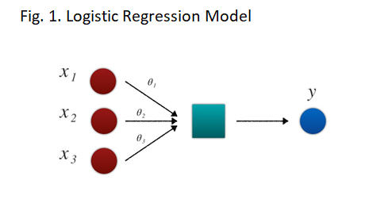
Logistic Regression Model
Logistic regression is a statistical method for analyzing a dataset in which there are one or more independent variables that determine an outcome.

Slide 4
LearningAPI – Logistic Regression
Normal Run
Batch Run

Slide 5
Logistic Regression Pipeline Modules
LearningAPI
DefaultDataMapper
Preprocessing - Validating and transforming data
Normalizing data
MinMaxNormalizer
LogisticRegression
Start
Setting the parameters for Algorithm
Run
Training the ML algorithm
GetScore
Obtaining the model to predict
Run
Predict the expected result
Batching raw data
Raw data is batched depending on batch size

Slide 6
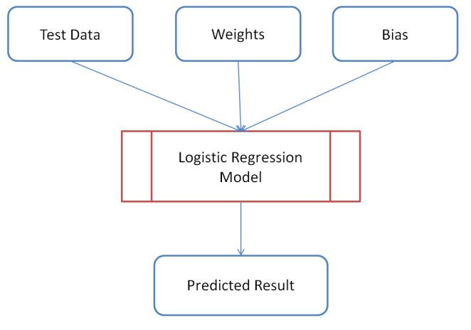
Unit Test Flow Chart
The flowchart for Unit Test

Slide 7
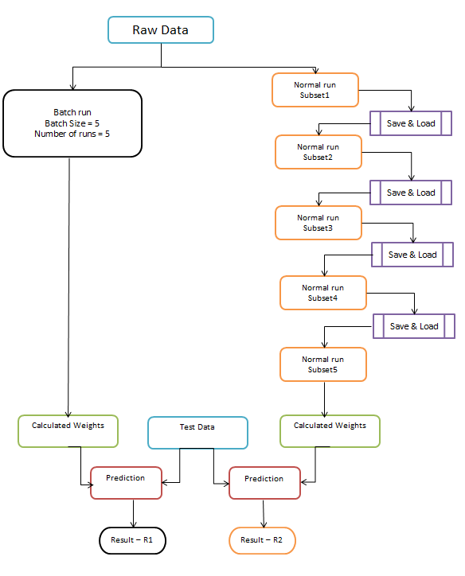
Unit Test Verification Method

Slide 8
Unit Test Cases executed
 | Name | Number of data rows | Number of features | Test(Pass/Fail)
1 | LogisticRegressionBatchTests | 25 | 4 | Passed
2 | LogisticRegressionBatchTests2 (with different batch size) | 25 | 4 | Passed
3 | LogisticRegressionVerification (with subset of 5 data in a given time) | 25 | 4 | Passed
4 | LogisticRegressionBatchwithCSV | 397 | 3 | Passed
5 | LogisticRegressionVolumeTest | 41189 | 10 | Passed

Slide 9
Reference
https://github.com/UniversityOfAppliedSciencesFrankfurt/LearningApi
https://github.com/UniversityOfAppliedSciencesFrankfurt/LearningApi/blob/master/WorkingWithBatches.md
https://machinelearningmastery.com/logistic-regression-tutorial-for-machine-learning/
https://christophm.github.io/interpretable-ml-book/logistic.html
https://medium.com/greyatom/logistic-regression-89e496433063

Slide 10
Project Links
Project Folder: https://github.com/UniversityOfAppliedSciencesFrankfurt/LearningApi/tree/logisticregression-batching/LearningApi Unit Test: https://github.com/UniversityOfAppliedSciencesFrankfurt/LearningApi/tree/logisticregression-batching/LearningApi/test/logisticregression Documentation: https://github.com/UniversityOfAppliedSciencesFrankfurt/LearningApi/tree/logisticregression-batching/LearningApi/Documentation

